Slide 1
Class 1: Shamanic Skills
What is shamanism? Setting space. Grounding, embodiment and protection.

Slide 2
What is shamanism: definitions
Anthropologically…
Shamanism” has been recently described as a form of interaction between a practitioner and spirits, one that is not available to other members of a community; the practitioner (a “shaman”) acts on behalf of that community—or on behalf of individual members of that community—to perform a variety of social roles that may include healing as well as harming, affecting the outcome of subsistence activities, and so on, by intervention with spirits or through knowledge gained by communication with spirits (see Webb 2013 under the Nature of Shamanism, p. 62). As such, shamans are found in a variety of cultures that are not traditionally associated with the concept, for example as spirit mediums in sub-Saharan Africa and through spirit possession in East Asia. This bibliography considers these themes through sections on the history of the concept itself, studies of the nature of shamanism, and analyses of shamanism in various cultures around the world.” …Oxford Bibliography webpage

Slide 3
What is shamanism: definitions
A shaman has an animistic world view. An animist understands that all parts of Creation are alive in some way, and have spirits. Nothing is dead in the animist’s universe - you and I have souls, and so do all the animals and plants, and likewise the rocks and rivers, mountains and clouds, stars, sun and moon, even an illness, or a concept, or a ceremony, or a ritual object has a soul - everything has a soul, and we live within a vast network of interconnectedness. All animistic and shamanic cultures understand this. All shamanic cultures are animistic - but not all animistic cultures are shamanic… A shaman is someone who goes into trance, and in that trance, they are either taken over by ancestor spirits - who were shamans before them - or they get taken over by local gods and spirits, such as the spirit of a mountain or a lake, or their soul leaves their body, and travels out to the other spirit worlds which are all around us - unseen - there to meet with spirits, so as to gain knowledge and power. Often all of these things happen within the same shamanic tradition.” Nicholas Breeze Wood; Sacred Hoop Magazine Special Guide to Shamanism

Slide 4
So…
Anthropologically a “shaman” is a skilled person who:
Is called by the spirits
Goes into a trance, using a variety of means, and leaves their body, travelling to other worlds/times/dimensions; or becomes possessed by a specific spirit in order to
Get information (divination); do healing work; or do other works for members of their community or their community as a whole.
Shamans often go through some kind of initiation
They are also trained by humans
Over ancestral time, people who had these skills became druids, priests, priestesses as societies moved into more hierarchical structures

Slide 5
Shamans…
Usually believe in evil and good…those things are culturally mediated/determind
Can have specific skills…weather shaman, deathwalker, animal stalker, exorcist, plant shaman (I call these are “magics”) or specific healing abilities (aka “having the cure): midwife, bonesetter, cures cattle, etc.
In some societies, shamans are expected to fight with shamans of enemy tribes…they’re not inherently good or nice or compassionate or egoless
Can curse (and some do) and in some societies are expected to
Modern western spiritworkers have an emphasis on healing work done on humans. There’s so much more to it than this.
Ultimately, shamans are mediators between humans and the Other, whatever that Other may be: the dead, spirits, elementals, the Fae, land spirits, gods/goddesses, Ancestors. In my view, shamans are often the voice of the voiceless. It’s an inherently political job.

Slide 6
Misconceptions
Shamans are all love and light (oh yeah NOPE)
Shamanism is safe
You’ll become enlightened/all shamans are enlightened/are “lightworkers”
Intrinsically healers/have to do healing work
Has something to do with any kind of new age/self help stuff

Slide 7
What practicing shamanism can do
Put you in deeper connection with your own spirit guides, higher self, ancestors and even your descendants
Put you in deeper connection with Nature and the Cosmos
Help you live more authentically as yourself
Can help you solve life problems
Enable you to co-create your life with spirit and so create a more balanced, authentic, honest, Earth-supporting life
Enable you to co-create ceremonies, ritual with spirit
Empower you and enable you to stand in your power

Slide 8
What shamanism can’t do
Protect you from everything
Control everything
Insulate you from life lessons (it can help mediate that, though)
Make you enlightened
Make you always happy/satisfied

Slide 9
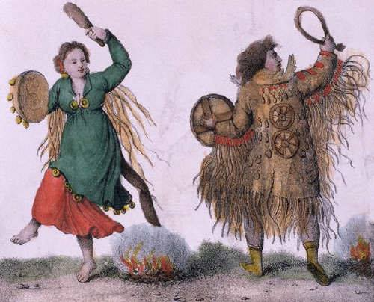
Questions?

Slide 10
Setting a Place to Work
We’re setting an energetic container here. Boundaries. Who/what can come in and help and who/what must stay out.
Purify and consecration of space:
Cleaning (!)
Fumigation/spraying: Mugwort, roses, white sage, rosemary, frankincense, myrrh
Salt
Rattling, clapping, stomping
Crystals/crystal grids (usually if you’re going to do heavy duty work)
Reiki
Candles (white or beeswax)

Slide 11
Setting a Place to Work: Calling in the Directions
East
Eagle
Air
Spring
Yellow/White
South
Deer Mother
Fire
Summer
Red
West
Salmon of Wisdom
Water
Autumn
Blue
North
Bear Mother
Earth
Winter
Black

Slide 12
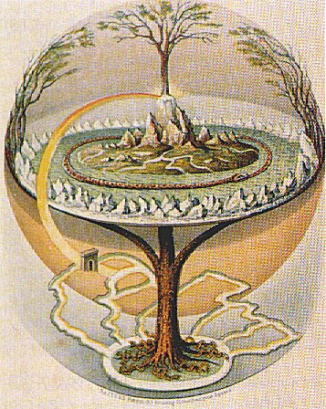
Setting a Place to Work: Calling in and Greeting the Worlds

Slide 13
Setting a Place to Work: Calling in and Greeting the Worlds
Lower World
Ancestors
Spirit Animals
Very Earth-like
Middle World
Here!
Spirits of place (land, buildings), elementals, moons, stars, planets, star beings, arch angels, etc.
Upper World
Deities, ascended masters, teachers, etc.
Very ethereal, fantastic

