Slide 1
Upper World Journeys

Slide 2
Winter Solstice
Nadir of the year: least amount of light, longest night in Northern Hemisphere
It is actually a 4-day period where the sun’s passage through the sky does not change.
The astronomical solstice is the longest period of night/shortest day.
Celebrated throughout Europe
Huge celebration at Neolithic site of Stonehenge related to the Ancestors and possible “river burial”. People came from all over Britain.
Newgrange passage site calibrated to capture the rising sunlight on the four days of the solstice. This does have to do with the Ancestors as well, though no one is exactly how.

Slide 3
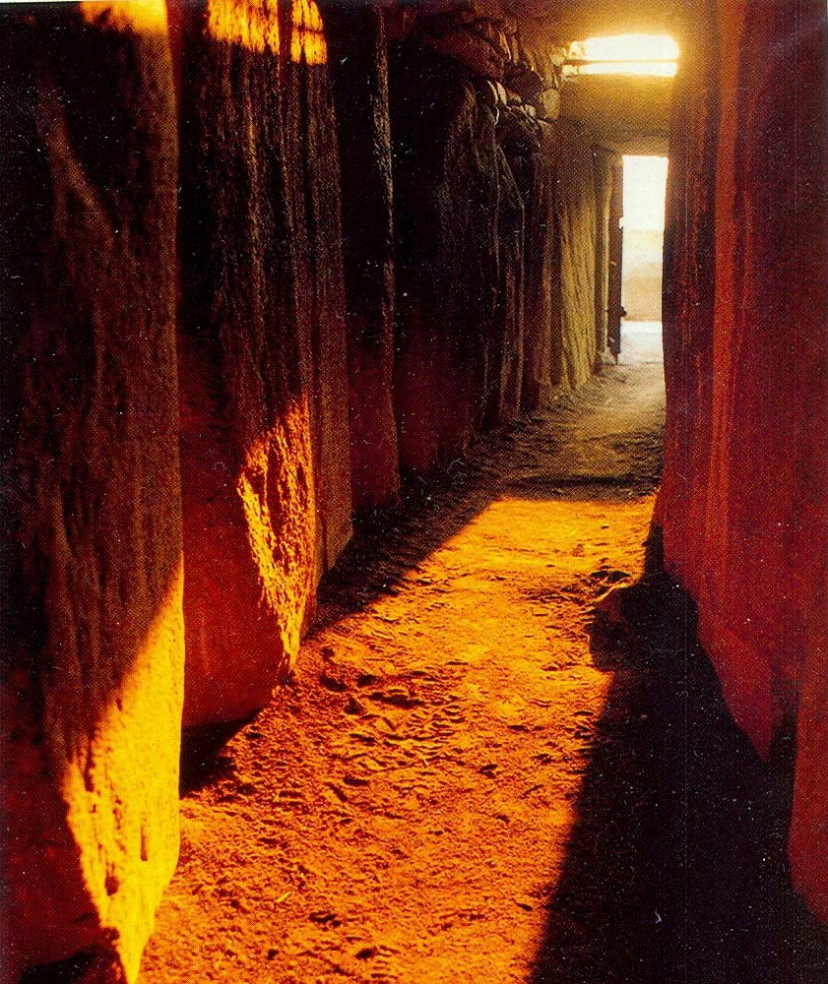
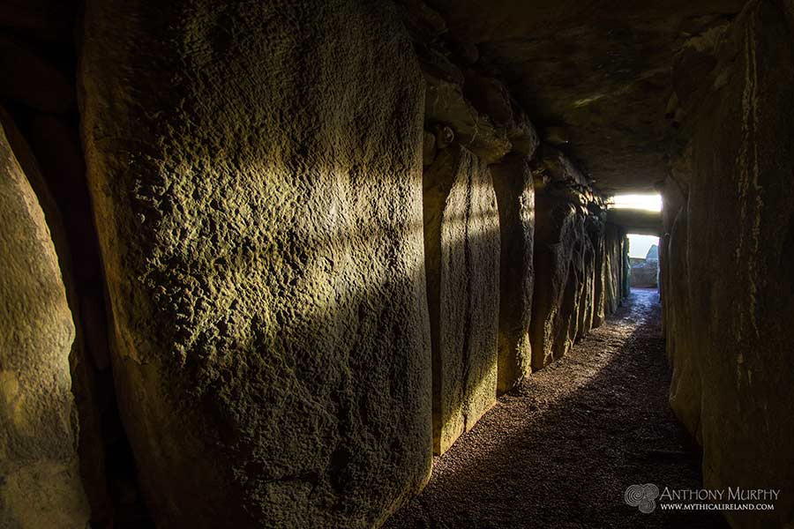
Winter Solstice

Slide 4
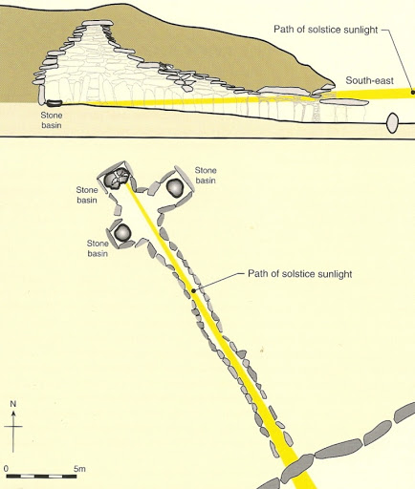
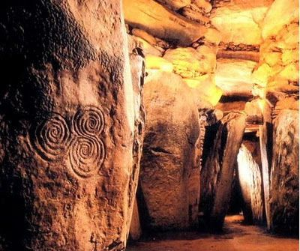
Winter Solstice

Slide 5
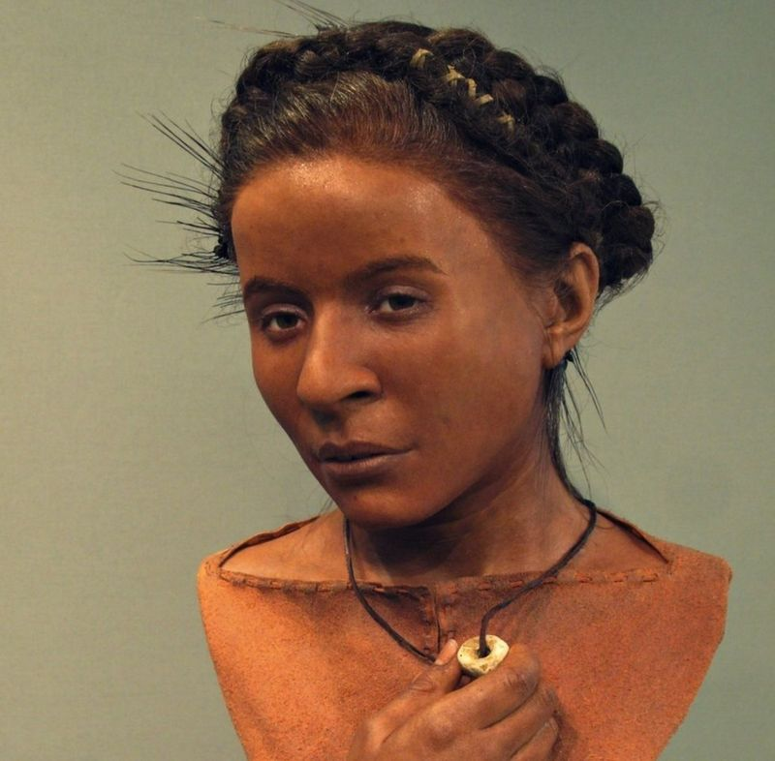
Winter Solstice
This is Whitehawk woman.
She has been reconstructed via a combo of DNA analysis and facial reconstruction.
She was found near Stonehenge and lived during the Neolithic in Britain.

Slide 6
Last Week’s Homework
How can I best articulate my energy to support or create positive changes to help all beings?
What can I do to help create or support a collective shift to make the world more just for all beings?
What can I do to help create or support a collective shift to make our country more just for all humans?

Slide 7
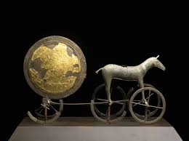
Upper World Journeys

Slide 8
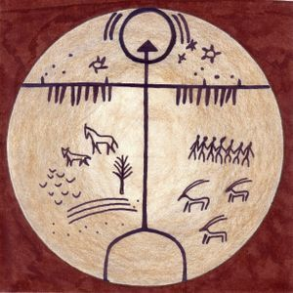
Upper World Journeys

Slide 9
Upper World Journeys
Upper world is outside our dimension
There is often a type of barrier or sense of going through a barrier or membrane
There is often a gatekeeper of some sort
You may need to offer something
You may need to try to get up there several times…they need to know you’re serious
It’s more of an ethereal place; more fantastical
Gods, Goddesses, Ascended Masters, Spirit Teachers, Soul Guides, some Ancestors, Plant Spirits…sometimes Animal Guides or other guides…mythical animals. My psychopomp guide “lives” here.

Slide 10
Upper World Journeys
Upper World beings can have various forms
Can visit here
To get teachings
To ask for a healing
Meet with spiritual advisors
Some healers do most of their healing work in this world
Like the lower world, the upper world is comprised of “layers”

Slide 11
Upper World Journeys
Visit the Upper World
Meet a Spirit Teacher in Human Form
Ask for a healing from your Spirit Teacher

